Slide 1

Early detection of Alzheimer's disease
CB.AI.U4AIM24039 SHEKU VENKATA ASHOK SAINAADH
CB.AI.U4AIM24047 SWATIKA V K
CB.AI.U4AIM24048 T. HARINI
CB.AI.U4AIM24054 M NEIL KUMAR
Guided by,
Dr. Prem jagadeesan
Dr. Manimaran
1

Slide 2
INTRODUCTION
Alzheimer’s disease is a neurodegenerative disorder that leads to the progressive decline of memory, cognition, and daily functions
Early diagnosis is crucial for timely intervention and treatment to slow disease progression.
Advancements in Machine Learning and Data Structures & Algorithms enable the automatic detection of early-stage Alzheimer disease.
This project aims to develop a predictive model using Support Vector Machines and optimized DSA techniques to classify patients based on Early-stage Alzheimer’s symptoms.

Slide 3
PROBLEM STATEMENT
It is challenging to detect Alzheimer's disease in the early stages due to subtle changes in brain structure and cognitive function.
Traditional diagnostic methods (clinical evaluations, cognitive tests) often lead to late-stage detection, reducing treatment effectiveness.
Detection of Alzheimer's in its early stages is still quite challenging because there are very subtle changes in the structure of the brain and cannot be detected manually

Slide 4
OBJECTIVES
Develop an automated model for early Alzheimer’s detection using SVM.
Leverage optimized Data Structures & Algorithms for efficient feature selection, classification, and prediction.
Compare the performance of the proposed SVM-based model with other machine learning approaches.

Slide 5
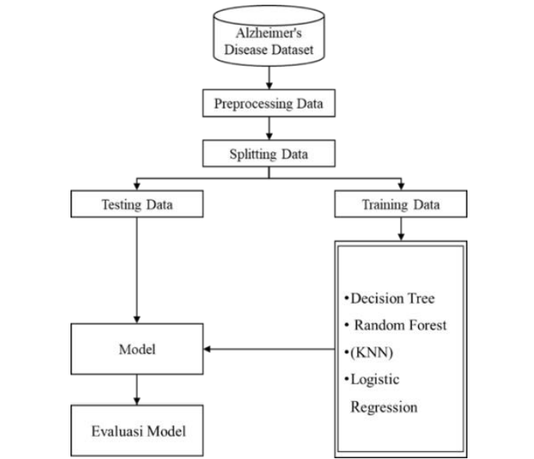

METHODOLOGY
SVM
Evaluating model

Slide 6
Data Structures & Algorithms
Arrays provide a simple and efficient way to store and access data in a contiguous block of memory.
They support efficient querying and manipulation of data, allowing you to organize and process large amounts of information effectively.
Linked lists offer flexible storage with efficient insertions, deletions, and dynamic memory allocation for changing datasets.
Arrays & Matrices
Linked Lists

Slide 7
Data Structures & Algorithms
SVM is particularly effective in high-dimensional spaces because it maximizes the margin between classes, making it less prone to overfitting. This ensures that even with a large number of features, the SVM can efficiently identify the decision boundary that best separates the classes (e.g., Alzheimer's vs. No Alzheimer’s).
Sorting improves data processing speed by enabling efficient searching and retrieval, reducing time complexity.
SVM
Sorting Algorithms

Slide 8
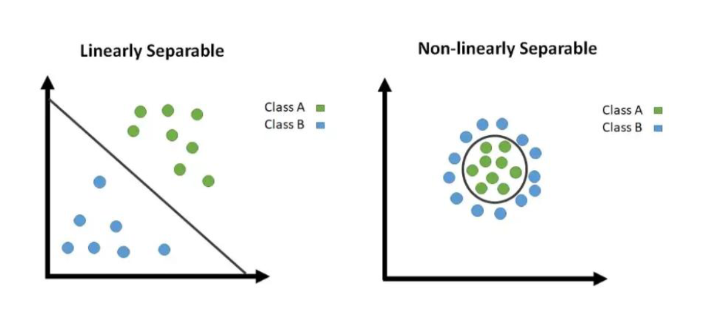
Mathematical concepts
SVM works by mapping data to a high-dimensional feature space so that data points can be categorized, even when the data are not linearly separable.
In SVM divides the data into two classes, not only two it can be multiple classes
from which we can classify or regress the data easily
The division of the data into multiple classes
is done by SVM by constructing the HYPERPLANE ,
it gets the maximum separation between the classes.

Slide 9
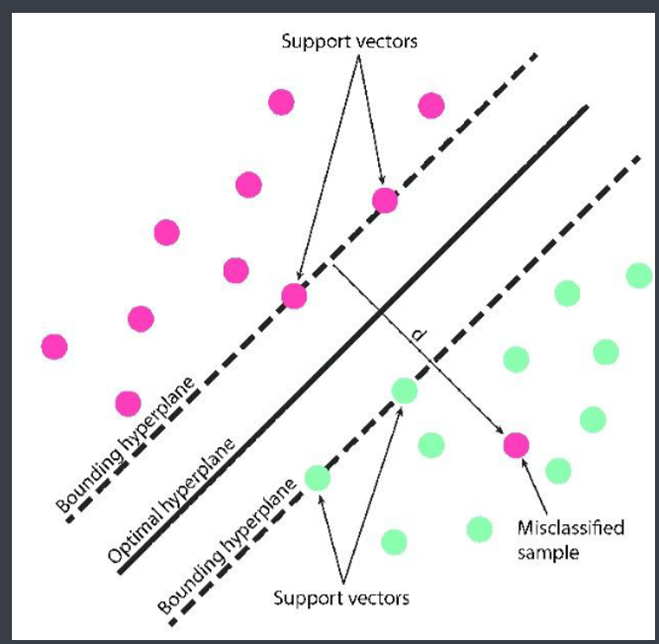
1. Bounding
2. Hyper Planes
3. Margins
4. Support Vectors

Slide 10
Literature Review
S.No. | Paper | Author | Year | Algorithm used | Research gap
1. | Alzheimer's patients detection using support vector machine (SVM) with quantitative analysis | Abhilash Sharmaa, Sukhkirandeep Kaurb, Naz Memonc, A. Jainul Fathimad, Samrat Raye, Mohammed Wasim Bhatt | 2021 | SVM model | Small sample size
2. | Non‑invasive Biomarkers for Early Detection of Alzheimer’s Disease: a New‑Age Perspective | Niyamat M. A. Chimthanawala, Akash Haria, Sadhana Sathaye | 2023 | SVM model | Limited accuracy, small sample size
3. | Early Detection of Alzheimer’s Disease with Blood Plasma Proteins Using Support Vector Machine | Chima S. Eke , Emmanuel Jammeh , Xinzhong Li , Camille Carroll, Emmanuel Ifeachor | 2021 | SVM model | Small and homogeneous sample size, Lack of Validation
4. | Deep Learning Approach for Early Detection of Alzheimer’s Disease | Hadeer A. Helaly, Mahmoud Badawy, Amira Y. Haikal | 2021 | CNN(Convolutional Neural Network) | Small sample size, computational complexity
5. | Multimodal deep learning models for early detection of Alzheimer’s disease stage | Janani Venugopalan, Li Tong, Hamid Reza Hassanzadeh, May D. Wang | 2021 | deep learning model | Small sample size, limited accuracy

Slide 11
THANK YOU

